Slide 1

Eclipse Ballooning Project
Bianca Pina – Science Research Lead
Paul Ronquillo – Electrical Engineering/Programming Lead
Jefferson Fleming – Structural Engineering Lead

Slide 2
Abstract
Arizona State University’s role in the Eclipse Ballooning Project is to measure the atmospheric changes induced by the 2017 solar eclipse to better understand how solar eclipses affect earth’s atmosphere. Our results should demonstrate that changes in the solar radiation due to the eclipse causes fluctuations in the atmospheric temperature and pressure. These fluctuations are predicted to create atmospheric gravity waves that permeate the layers of our atmosphere. We expect to find that atmospheric gravity waves cause variations in temperature, wind speed and energy distribution. The data collected from the payload will be analyzed by the ASU Eclipse Ballooning Project team and by The Radiosonde Project.

Slide 3
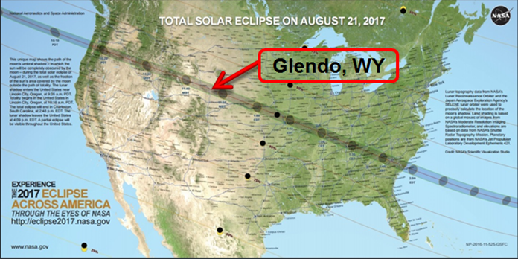
Objective
To measure direct and indirect changes to these metrics due to the eclipse:
Solar Radiation
Temperature
Humidity
Pressure
Thermal Imaging

Slide 4
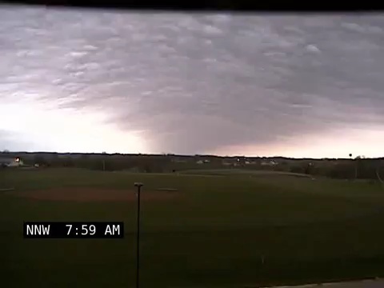
Atmospheric Gravity Waves
Notes:
https://youtu.be/yXnkzeCU3bE

Slide 5
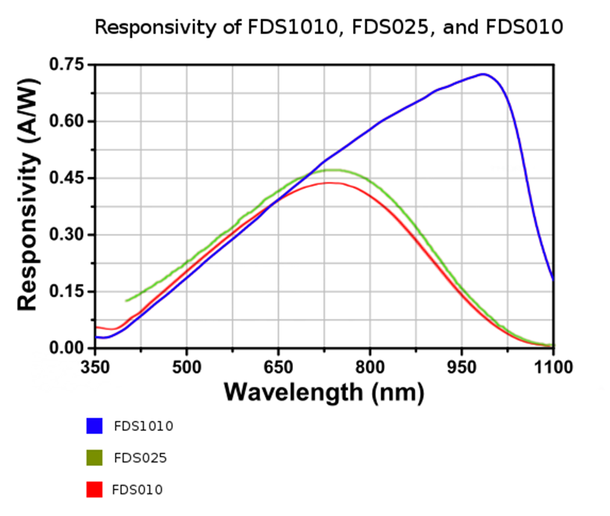
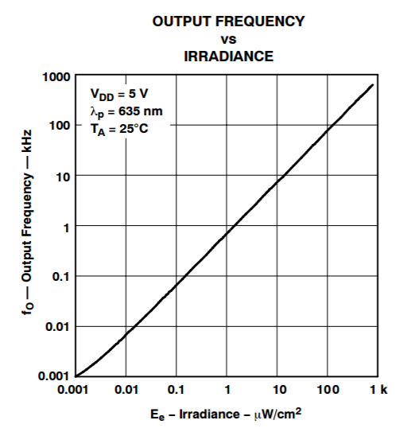
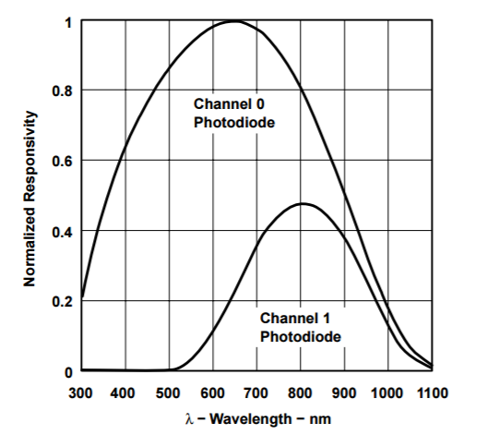
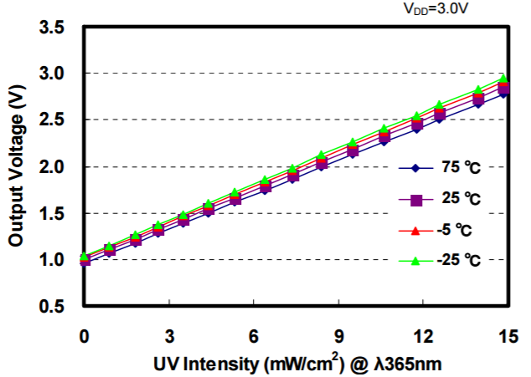
Solar Radiation
Three photodiodes that detect wavelengths in the visible and IR spectrum
Luminosity, Light-to-Frequency and UV Sensors will provide additional data

Slide 6
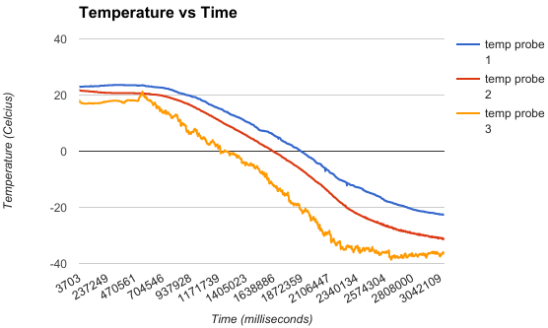
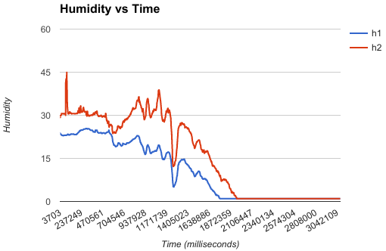
Temperature/Humidity
The DHT22 is a capacitive humidity sensor and a band gap temperature sensor all in one.

Slide 7
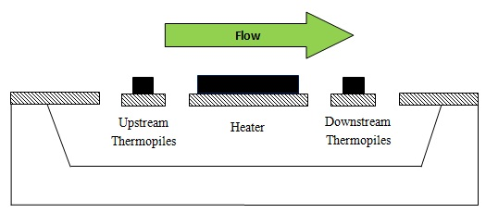
Pressure
To detect very small pressure fluctuations (+/- 2pa) we will be using a thermal micro-flow barometer. We will also incorporate an absolute pressure sensor to complement this.

Slide 8
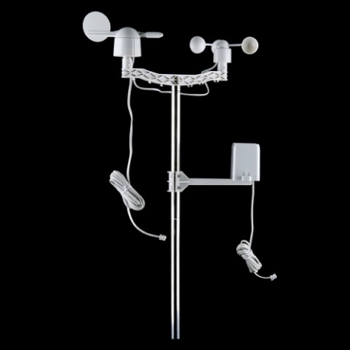
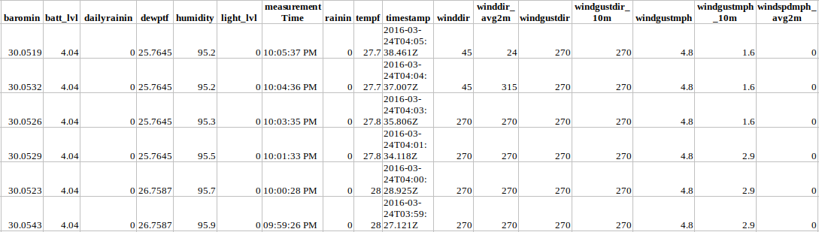
Weather Meter
Wind Speed and Direction
Temperature
Pressure
Humidity

Slide 9
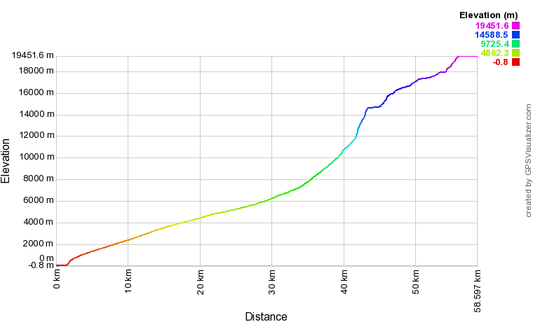
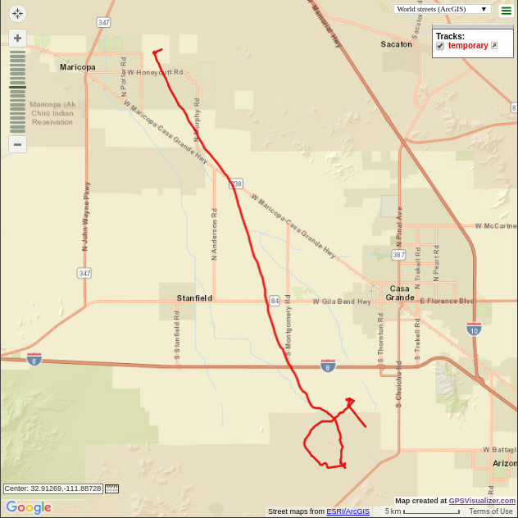
Global Positioning System
The Venus GPS is very unique because it can update it’s location up to twenty times a second.

Slide 10
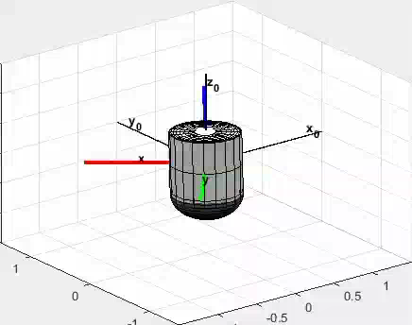
Acceleration-Orientation-Magnetic Field
Notes:
https://youtu.be/vnYdkRZzBqM

Slide 11
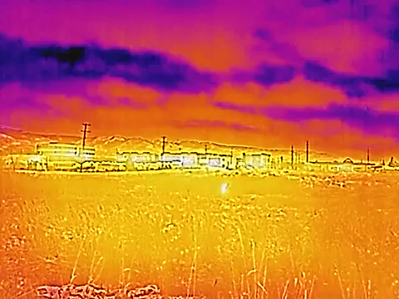
Thermal Imaging
Notes:
https://youtu.be/4CJI-7JwTa0

Slide 12
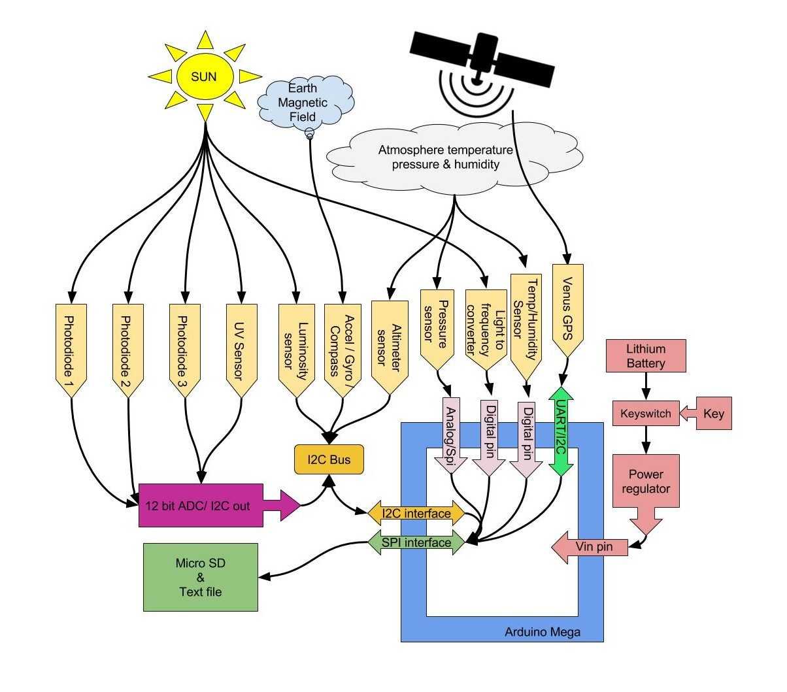
Electronic System
Single point startup key switch
Dedicated ADC for higher analog sensitivity
Poll each sensor, then log new line
Log speed tuned to match Venus GPS full speed
Arduino Mega program capacity 256Kb instead of 32kb

Slide 13
Acknowledgments
Montana Space Grant
Dr. Tom Sharp - Mentor
Jack Crabtree - Partnering Mentor
Desiree Crawl - NASA Space Grant Senior Coordinator
Laura Zimmerman - NASA Space Grant Specialist
School of Earth and Space Exploration

